Slide 1
Module 4: Clustering
Kmeans: Unsupervised (Dont know labels, k nearest neighbors do know labels) Centroid Based, No overlap (Partitional Clustering)
Class labels should not be used in clustering, only in validation
Points Assigned to closest centroid, boundaries circle if euclidean distance
K assigned rand., select k pt centroids & recompute centroid of each cluster
Distance measured in euclidean, cosine, correlation so that intra-cluster distances minimized & inter-cluster distances are maximized, ambiguous
Will converge for similarity measures, stopping condition changed to few points change clusters
Strengths: Simple, many use formats, efficient, bisecting less susceptible to initialization problem
Weaknesses: Not good for non-globular clusters/different sizes, outliers. Data must be homogenous, non circular shapes do not classify well, bisecting may be expensive
Complexity: O(n*K*I*d)n=# points, K=clusters, d=#attributes, i=#iterations
Kmeans reaches local or global minimal, will not alter assignment of samples to cluster for multiple iterations. Chance is lower when k is larger
Centroid Problem: Each assignment updates after assignment (incremental approach), each assignment updates 0 (if same cluster) or 2 (if different) centroids (more expensive). Introduces order dependency
Bisecting K-Means: Evaluates 2 centroids,prob of selecting wrong reduced
Divides dataset into 2 clusters recuresvilly until number of clusters is reached., choose largest cluster at each step, get largest SSE or own criterion. Has less trouble with initialization as it performs several trial bisections & takes lowest SSE, results refined using centroids from bisecting k-means as initial centroids for basic -means algorithm
Evaluate K-means cluster: Obj func. Of quality for clustering
Sum of squared error, for each point, the error is the distance to the nearest cluster, we then square & sum. X is a data point in cluster ci & mi is the representative point for cluster ci, ci corresponds to mean of the cluster, then choose smallest error. Reduce SSE by increasing K, K-Means algorithm is guaranteed to find a clustering that represents a local min with respect to SSE, Definition imprecise & depends on nature of data
Silhouette Coefficient: Evaluate quality of clusters produced
Types of clustering: K-mean, DBSCAN, Hierarchical
Partitional Clustering: Division of objects into non-overlapping subsets, each data object is one subset
Hierarchical Clustering: Set of nested clusters organized as tree, cluster can have sub clusters, each node (cluster) in tree is union of sub clusters (Children) & root is cluster containing all objs, can be dendrogram
Often displayed graphically using tree like diagram
Produces set of nested clusters records sequences of merges or splits
Can cut dendrogram to certain amount of clusters
Do not assume taxonomies
Strengths: Does not assume k, corresponding classes such as summarizes whole animal kingdom
Agglomerative: Start with the points as individual clusters & at each step merge the closest pair of clusters. Min: 2 closest pts in diff clusters, max: farthest 2 pts in different clusters, dendo changes on prox. function
Divisive: Start with one all inclusive cluster & at each step, split a lucster until only singleton clusters of individual points remain.
Performance Analysis of Clustering:
Time & Space: O(N^2) for proximity, n is # points. O(N^3) - There are n steps & at each step the size must be updated & searched, can be reduced to O(N^2log(N) if using heap or sorted list
Min Strength: Good when cluster sizes different, not for non circles
Min Weakness: Susceptible to noise
Max Strength: Not sensitive to noise & outliers
Max Weakness: If big & small clusters, will break down big
Group Avg Strength: Compromise btwn single & complete links, less susceptible to noise
Group Avg Weakness: Biased towards globular clusters, convex shapes
Distinctions
Exclusive vs. Non exclusive, Non exclusive - points belong to multiple clusters, person at university is enrolled as student & employee
Can represent multiple classes or border points
Fuzzy vs. Non-fuzzy, Fuzzy clustering - Point belongs to every cluster with some weight 0-1 weights sum to 1. Converted to exclusive clustering by assigning each obj to the cluster where weight is highest
Partial Vs. Complete: Cluster data & leave out samples s/a noise & outliers
Heterogeneous vs. Homogeneous:Different sizes, shapes, & densities
Cluster Types
Well separated -Pts. s/t any point in a cluster is closer to every other point in the cluster than any point not in the cluster, any shape, clusters separated
Center Based - Pts s/t an object in cluster is closer to the center of another
Contiguous (Nearest Neighbor) - Clusters close but points define edges for the most points, two objs connected only if in a specific distance, trouble with noisy data where a small bridge of points can merge 2 clusters, dist.
Density Based - Cluster is dense region, separated by low density regions, regions defined by high density. For when clusters irregular/intertwined, or when noise & outliers are present, cluster not merged by noise, dens.
Obj. Function - Points go through obj function to find max or min, enum all ways of dividing points into clusters, map clustering problem to different domain & solve problems, proximity matrix defined a weighted graph, where nodes are points being clustered, ,& weighted edges represent proximities between points, cluster equivalent to breaking the graph into connected components one per cluster, minimize edge weight between clusters & maximize edge weight within clusters
Density Based Clustering: DBScan: Locates high density from low density, center based, density based on # points in radius
Core Points: Interior of density cluster, eps & min pts. defined must be min pts. In specified area.
Border Points:Not core, falls in neigh. of core point,min points not in radius
Noise point: Neither a core point nor a border point, outside all neighborhoods, has less than min point
Algorithm: Label all points (core,border,noise), eliminate noise, put an edge between all core points within eps, make each group a cluster, assign each border point to core point cluster
Strengths: resistant to noise & weird shapes, arbitrary sizes
Weaknesses: Varying densities, high dim data density hard to define, can be expensive when the computation of nearest neighbors requires all pairwise proximities, high dim data
Time Complexity: O(n*time to find pts in eps neigh.) n is # pts
Worst Case O(n^2), Space: O(m)
Steps: for pts in same cluster, value of k-dist will be small if k is not in larger cluster size, for noise points k-dist will be large, epsilon depends on k but does not drastically change with`k
Cluster Validity
Don't have ground truth
Avoid finding patterns in noise, compare algorithms, compare 2 sets of clusters, compare 2 clusters
Aspects of Cluster Validity Determine clustering tendency & maintain data characteristics, Determine # clusters
Evaluate how results fit without external info, do clusters fit & make sense?
Compare results to external results, match with external labels
Compare results of 2 diff. sets of clusters to determine accuracy
Measures of Validity
Unsupervised: Measure clustering w/o respect to ext. info, 2 classes cluster cohesion & separation called internal indices, no class levels
No external information
SSE: Maximize, Measures intracluster,as clusters increase, SSE decreases, does not capture intercluster distances, SSE 0when all data points are own cluster
Cohesion:Correlation of objs, in a cluster, sum of weight for links in cluster
WSS: Std of given cluster, minimize
Seperation: How well separated a cluster is from other clusters, sum of weights between nodes in the cluster nodes outside the cluster
BSS: Overall mean of the data, maximize for well separated data
Relation: WSS & BSS is a constant & = to sum of squares. TSS is computed from the sum of squares of the distance top each point in the overall mean of the data, minimizing WSS is equivalent to maximizing BSS
Supervised: Measures extern. structure with class levels, extern. indices
Measure degree of correspondence between cluster & class labels, compare against ground truth, measures are entropy & purity .
Entropy - Degrees to which cluster consists of objects of a single class, low values: better clustering, higher values fuller clusters
Relative: Compares different clustering, supervised or unsupervised, use of measures, not a separate type, compares clustering techniques
Silhouette Coefficient:Si=(bi-a)/max(ai,bi)
How similar are objects to its own cluster: -1-1
1: Well clustered and,much closer to other points in its own cluster
0: Close to decision boundary between 2 clusters
-1 Data point assigned to wrong cluster
Avg distance to all other objs in cluster(a)
Calculate its avg distance to all objs in a cluster not containing the obj, find the minimum of these values with respect to all clusters(b)
External Validity:Measure compares result against ext. or ground truth
Correlation Validity
Similarity matrix, goodness of clustering between similarity matrix & ideal
Ideal cluster is 1 to all points in cluster, & 0 to other points
1x1 mtx for each data pt. & assign a 2 to entry if they belong to same cluster
Module 5: Association Rule Mining
Associate rules should not have practical explanations
Antecedent (Notion if you buy) -> Consequent (You’ll also buy)
Confidence is asymmetric, support is not
Item set - A collection of 1+ items, Kitem set = item set of k items
Support Count - Frequency of occurrence of an item set
Support - Fraction of transactions that contain an item set
Freq Item Set:Item set whose support is greaterthan=to minsup threshold
Association Rule Implication expression X-> Y, where X & Y are itemsets (Milk, Diaper) -> (Beer)
Support & Confidence
Support: May occur by chance
Confidence: Measures the reliability of the inference made by a rule
Want moderate support & high confidence
Confidence A->{} = 1
Need support & confidence to understand association rule mining task both greater than minsup & minconf of threshold
High confidence, low support = not common
Brute force: List all possible association rules, computer sup & conf for each, prune rules that fail thresholds, computationally expensive, tidal rules Rules = 3^d - 2^(d+1) + 1, itemset * rules
Itemsets: Given d items, 2^d candidate itemsets including null set
Given ddd items, we can derive 2^d or less items
Apriori Principle
Subset of itemsets that are frequent are frequent
Supersets of itemsets that are not frequent are not frequent
Rule Generation, Level Wise approach, high confidence rules that have only one item in the rule consequent are extracted
{a,c,d}->{b} & {a,b,d}->{c} THEN {a,d}->{b,c}
Reduce complexity of brute force search
If an item set is frequent, then all its subsets are also frequency, X&Y>= minsup. Supp(X)>=Supp(Y)
STEPS: Calculate bottom support, all items on top connecting are subsets & support doesn't need to be calculated
Start with len 1 freq. itemsets, use the Apriori to prune infreq. candidates.
Gen len k+1 candidate itemsets from freq. k-itemsets, repeating until no new freq. itemsets are identified.
Perform additional passes over the dataset as needed, avoiding the generation of unnecessary candidate itemsets.
Candidate generation involves creating new candidate k-itemsets based on frequent (k-1)-itemsets found in the previous iteration.
Candidate pruning eliminates candidate k-itemsets using support-based pruning techniques, ensuring the completeness of the candidate set.
Algorithm needs to make an addl. Pass over
Candidate Generation: Generate new candidate k-itemset based on freq. K-1 itemsets in prev. Iteration
Candidate pruning: Elims some of candidate k-itemsets using supp based pruning
Generation and pruning generates k-1 itemsets based on k-1 itemsets and eliminates dome of the candidate k-items
Avoid generating unnecessary candidates, candidates set is complete
Factors that affect complexity: choice of minimum support threshold, the dimensionality of the dataset, the size of transactions, and the width of transactions. Challenges incl. finding initial itemsets to start with and determining optimal ordering of itemsets to min. computational overhead.
Rule generation: Freq of occurrence for every candidate c that survives pruning, compare each transaction against every candidate itemset
X = {1,2,3} = 3^2 = 0 combos make {1,2} -> {3} goes down to 6 rules
Anti-monotone property of support ensures {1,2} must be frequent too
Support Counting
Freq of occurrence for candidate items that survives candidate pruning step
Compares each transaction against every candidate itemsets, enumerate
Frequent itemset generation: All item sets whose support >=minsup
Challenges include: gen. unnecessary itemsets and gen. same itemset 1+
Rule Generation: High confidence rules from each freq. Itemset
First search rules with highest supp, then find min confidence,
Reduce # of candidate itemsets - Apriori
Reduce # of comparisons, use more advanced data structures
Module 6: Deep Learning
GPUs changed deep learning, Help overcome cold start problems
Caused from increase in compute power and overall data
XOR problem led to non-linear neural networks in form of multilayer perceptron. Single perceptron has linear boundaries & cannot solve nonlinear problem of XOR, gap resulted in multi-layer perceptron to solve
Deep Neural Network
ANN->Feed forward, greater than 10 hidden layers, each w/ 50-100 nodes
Recurrent Neural Network: Hidden layer with inputs & outputs, output fed back to input with a weight to unroll infinitely as hidden layers
Solves seq. problems to extract knowledge from time series, has self loops
Represent temporal sequences, less suitable for hierarchical data
Weaknesses: Slow to train, vanishing gradients, difficult long term dependencies
Recursive Neural Network
Tree nets, sets of hidden nodes that feed forward into each other which then each node at each steps goes to another hidden layer
Combines child nodes with weight to produce parent
Advantages: Structure and network depth, with O(log n) binary tree height
Labeling data more time-consuming and labor intensive
Convolutional Neural Network
Knowledge from images, 3d neural net, each node performs convolution operation, X is a number, hidden layer is series of convolutions, feature extraction is a convolution with filters
Tools: Caffe, Tensor FLow, Keras, Theano
Recommendation System
Dont know true user preferences
Inputs User profile and user usage history
First entry point is user profile (age, gender, preferences)
Usage history (What was watched, length of watching, rating, season) Gain preference knowledge w/o asking & changes dynamically
Problem: Cold Start Problem
Item Based: To whom do I recommend new items to. No watch history select salient features & match with other items to find a set similar to new item. Find users that lie the matched set the most
User based: No usage history, match user profile with other users
Bayesian Network
Naive Bayes: Given a class, each attr. is cond. independent of one another
Complex Conditional Dependence: Multiple children nodes that each have subnodes that are directional to the subnodes
Deep Belief Network
Belief Network: Nodes are observable facts, roots are potential reasons/beliefs (May or may not be observable
Has several hidden nodes (hidden beliefs, stochastic output(random) from some activation function 0-1) to the set a probability is greater than a threshold. Hidden nodes serve as potential reasons or beliefs. Backprop used to update weights to reduce error and adjust output
Beliefs are associated with each other
Difficult to learn a belief network due to hidden layers & number of hidden layers, simplify using Restricted Boltzmann

Slide 2
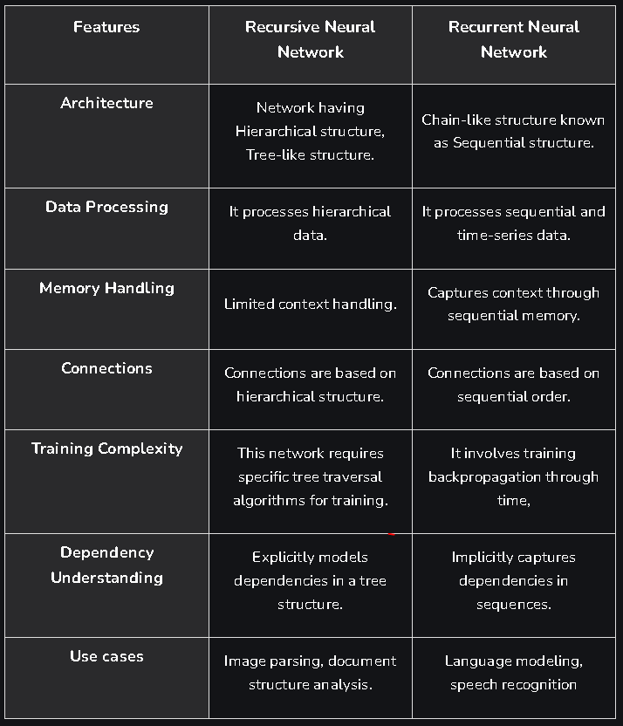

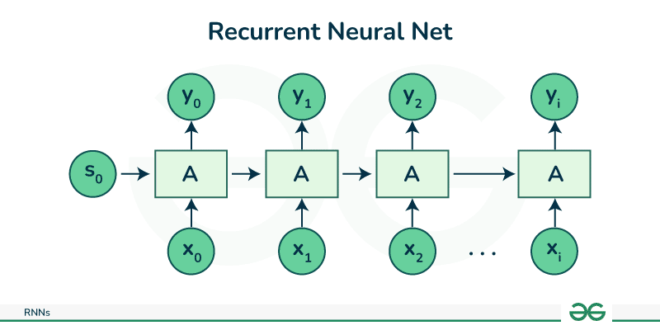
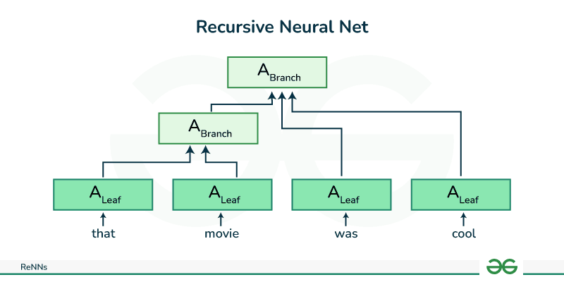
Restricted Boltzmann Used in recommendation systems
ANN w/ in. layer(observ)& hidden belief layer(not observ)for bipartite graph
Depends on educated guess w/ info extract gain information like use history
Backprop so input layer has items’ rating and hidden layer makes guess on user preferences
Output is wild guess about preferences
Hidden layer becomes input layer to reverse is, must do back propagation to reduce error & update weights to get true value, then reiterate to adjust output & get correct values in reversed model to guess closer to reality & can now guess correctly on new mode wil updated weights.
Stacked RBMs: In Layer(Reality) -> Hidden (Wild Guess in Boltzmann then make another hidden in -> hidden layer & so on…
Autoencoder: PCA of Deep neural nets
Good for classification & clustering
Input to small wild guesses, then reconstruct the input
Upon reconstruct just runs the in layer in reverse
Treat as feed forward network & input is the same as output
Reduces dim to small set of cognizant guesses, then reestimates to produce init. layer, then replaces input with reconstructed to reduce dim
Module 7: Markov Decision Processes
Markovian Prop: Next state only depends on current state & next action. Current state encapsulates all information from hist. Of system & future evolution of system depends only on the current state & action, not the entire hist. That led to the current state
Maximize cumulative reward in the long run
Model complex probabilistic approaches
MDP: Mathematical Construct
S -> Set of states, current status, valuation of Variables V
A -> Set of actions taken
T -> Transition Matrix, SxA, Deterministic trans. matrix goes to prob value
R -> Set of rewards: SxA -> Real Set R, R(s1,a1) provides real number
Rewards used to evaluate a policy and compare between policies. Rewards are available for each in a state.
Evaluate Policies: Pi(Policy), mapping from S->A, collection of tuples state 1 means action 1, given a state what action to take
Choose initial state, perform action pi(si), use trans. matrix to go to current state. Calculate reward, maximize it, & accumulate reward over time, compare 2 policies by seeing maxed reward
Value Functions
State value function: Vpi(S),Expected return from a particular state under given policy pi, calc val of being in a state following policy thereafter
State action val func:Qpi(S), Represents expected results starting from a particular state, taking a particular action, following policy pi after.
Qpi is the restricted value function that only applies to an action in a given state
Difference: Vπ evaluates the value of states under a given policy. Qπ evaluates the value of state-action pairs under a given policy.
Vπ represents the value function for a policy π, which is the expected return (total discounted reward) starting from a particular state and following policy π thereafter.
Qπ, on the other hand, represents the action-value function for a policy π. It gives the expected return starting from a particular state, taking a specific action, and then following policy π thereafter.
So, while Vπ gives you the value of being in a certain state and following a policy from there, Qπ gives you the value of taking a certain action from that state and then following the policy.
Calculates value of taking a particular action in a particular state & following policy thereafter
State action value function can used in greedy manner for choosing best action at current state.
Used for finding optimal policy using bellman equations, estimate from exp. Pick best state action value function
Dynamic Programming to Solve RL
Need perfect model env. & rewards(state space, action space, trans. model)
Divide into subproblems & have optimality of overall problem
Policy Exploration: Use value funcs. To structure for good policies
Components of dynamic programming to solve RL
Policy Eval: Compute Vpi from pi, state-value func for given policy pi
Policy Improvement: Improve pi from Vpi
Steps: Start with arbitrary policy, repeat eval until convergence, explore all possible option
Used to solve: Robot in a room, backgammon (Know end result & env)
Monte Carlo Evaluation: Don't need env, just need exp/simmed exp
Similar to DP in policy eval & improvement
Weaknesses: Uses greedy approach, approx. of optimal, not actual value
Policy Eval: Estimate Vpi(s)before env N times & average reward value, estimate as avg. of observed returns in state s
First visit MC, average returns following the first visit to state S
Averaging sample returns defined only for episodic tasks
Monte Carlo Policy Control
At every state you treat them as the maximum
Exploration: Greedy/Deterministic policy does not explore all actions, don't know env, need to find all, then maintain exploration by using soft policies instead (pi(s,a,)>0) for all s,a
Greedy policy: Chooses highest estimated value in given state to maximize. Always selects highest value.
Cons: May miss exploring other actions that potentially have higher return in long run
With probability 1-eps perform the optimal/greedy action with probability epsilon perform a random action.Explore random actions instead of always selecting greedy action with probability.
Explore env & slowly move it towards greedy policy epsilon -> 0
Temporal Difference Learning (TDL): Combines MC & DP
Dont need a model, learn from vals of successors
Works for continuous tasks, usually faster than MC, eval at every step
Comparisons & Use Cases:
Both MC & TDL dont need perfect model of env
Recursive Vs. Recurrent
Both process sequential data
Recursive: Good for tree-like or nested data, model relationships and dependencies in hierarchical arrangements, processes information hierarchically capturing contextual information efficiently. NLP, document parsing
Recurrent Neural Networks
Process sequential data, captures dependencies over time
Create loops within network, allowing them to maintain a form of memory. Retains information from previous time steps. Sentiment analysis, machine translation, Speech, handwritin, time series
Infinite time policy makes it difficult to compare
Finite Horizon analysis: Stop after certain time to stop infinity
Discount reward to make it harder for inf. ignore past rewards, most used
Expected reward instead of cumulative
Discounting: Val function Vpi(s: total discounted reward from s to policy pi
Bellman Equations: Recurvice way to eval value function
Vpi(S)=R(s,pi(s))+Sum(T(s,pi(s),s’)) add discounting factor multiplier 0-1
Pi(s/t Vpi(s) is maximized
Markov Chain: Fix a policy to execute it for longer
Reinforcement Learning: Stochastic or deterministic
Doesnt assume you have a model of env. Opposed to MDP
Ideal for sending a space rover to explore the surface of another planet
Learn from interaction/sim w/env. to overcome not having a complete model
More general than supervised/unsupervised learning, do not assume env.
Term. state: Action wont give reward, forever in state (ex. Each step costs .04 reward)
MDP Vs. Reinforcement Learning:Transitions not available, how to change policy on exp., how to explore env.
RL does not necessarily have knowledge of transition matrix and rewards by MDP knows them, RL learns from interaction with env. while MDP has a model of env.
Compute return from rewards
Episodic Tasks:Term after N steps, optimal pi relies on N,hard to analyze
Additive Rewards: Infinite Value for continuing tasks
Discounted Rewards:Vals bounded if rewards bound(+ weight multip.)Val

Slide 3
Theory
K-means:
Use K-means when you have a clear idea about the number of clusters you want to partition your data into.
Suitable for datasets where clusters are well-separated and roughly spherical in shape.
Efficient for large datasets, works well with num.l features.
May not work well with clusters of varying sizes or non-linearly separable data.
DBSCAN(Density-Based Spatial Clustering):
Use DBSCAN when the clusters have varying densities or irregular shapes.
Suitable for datasets with noise and outliers, as it can identify and ignore them.
Automatically determines the number of clusters based on the density of the data.
May not perform well with high-dimensional data or datasets with uniform density.
Hierarchical Clustering:
Use hierarchical clustering when you want to explore the hierarchical relationships between clusters.
Suitable for datasets where clusters can be represented as a tree-like structure.
Provides insights into the relationships between clusters at different levels of granularity.
Can be computationally expensive for large datasets and may not scale well.
Measurement of Clustering Quality:
SSE: Measures compactness of clusters. Sums the squared distances of data points from their respective cluster centroids. It reflects how well the data points are clustered around their centroids.
SSE: Lower SSE values indicate better clustering solutions, as they represent tighter and more compact clusters.
SSE: Primarily used in centroid-based clustering algorithms like K-means to optimize the placement of centroids and determine the optimal number of clusters.
SSE: Can be used in conjunction with the "elbow method" to determine the optimal number of clusters, where the rate of decrease in SSE slows down (the "elbow point").
Silhouette Coefficient: Measures both the cohesion within clusters and the separation between clusters. It calculates the average silhouette width for each data point, where a higher silhouette width indicates that the data point is well-clustered within its own cluster and poorly clustered with neighboring clusters.
Silhouette Coefficient: A higher silhouette coefficient value (ranging from -1 to 1) indicates better clustering quality. Values close to 1 suggest that data points are well-clustered, while values close to -1 indicate that data points may be assigned to incorrect clusters. A silhouette coefficient near 0 suggests overlapping clusters or poorly defined clusters.
Silhouette Coefficient: Widely used to evaluate clustering solutions in various clustering algorithms, including K-means, hierarchical clustering, and DBSCAN. It provides a more comprehensive assessment of clustering quality, especially in cases where the number of clusters is not predefined.
Silhouette Coefficient: Can be used to compare clustering solutions with different numbers of clusters. Higher silhouette coefficients indicate better clustering solutions, helping to identify the optimal number of clusters based on maximum silhouette score.
Partitional Clustering: dividing a dataset into non-overlapping subsets or clusters, where each data object belongs to exactly one cluster.
No overlap, each point has one cluster
Example: K-means where data points are assigned to the nearest centroid, resulting in non-overlapping clusters.
Dividing customers into distinct segments
Hierarchical Clustering: Organizes data into a hierarchy of nested clusters, represented as a tree-like structure (dendrogram)
Each node (cluster) in the hierarchy is a union of its subclusters (children), with the root representing the entire dataset. It can be agglomerative (bottom-up) or divisive (top-down).
Example: Agglomerative hierarchical clustering starts with each data point as a singleton cluster and merges the closest pairs of clusters iteratively until a single cluster containing all data points is formed.
Strengths: Does not require (K), provides a comprehensive summary of the dataset by capturing nested clusters.
Document clustering, hierarchy
Agglomerative Hierarchical Clustering: bottom-up approach where each data point starts as a singleton cluster, and at each step, the two closest clusters are merged.
Characteristics: The proximity between clusters determines the merging process, and the dendrogram evolves based on the proximity function used.
Agglomerative hierarchical clustering might merge clusters based on the Euclidean distance between their centroids or the single-linkage, complete-linkage, or average-linkage proximity measures.
Social Network analysis, reveals nested structures such as groups
Divisive Hierarchical Clustering: Definition: A top-down approach where all data points initially belong to a single cluster, which is recursively split into smaller clusters until each cluster contains only individual data points.
Characteristics: At each step, the cluster with the highest dissimilarity is split into two, until the desired level of granularity is reached.
Example: Divisive hierarchical clustering might split clusters based on maximizing the dissimilarity between clusters, such as maximizing the distance between cluster centroids.
Separating groups based on long term value, identifies high value segments
Min (Single) Linkage: calculates the proximity between two clusters based on the minimum distance between any two points in the clusters.
Characteristics: It tends to produce elongated, chaining clusters where individual data points close to each other.
Strengths:Effective for identifying clusters with elongated or irregular shapes, Sensitive to local density variations and can capture outliers effectively.
Weaknesses:Susceptible to the "chaining effect," where clusters can be connected by a series of single links, leading to long and narrow clusters, Prone to the "single linkage problem," where clusters can be overly sensitive to noise and small fluctuations in distance.
Max (Complete) Linkage: calculates the proximity between two clusters based on the maximum distance between any two points in the clusters.
Characteristics: It tends to produce compact, spherical clusters where data points are relatively close to the centroid of the cluster.
Strengths:Effective for identifying compact clusters with well-defined boundaries, Less sensitive to noise and outliers compared to min linkage.
Weaknesses:Tends to merge clusters based on the maximum distance, which can result in the fusion of unrelated clusters and the loss of smaller, densely populated clusters, Less suitable for detecting elongated or irregularly shaped clusters, as it may merge clusters prematurely based on the maximum distance criterion.
Exclusive vs. Non-exclusive:
Exclusive: In exclusive clustering each data point belongs to exactly one cluster.
Non-exclusive: In non-exclusive clustering to multiple clusters simultaneously. For example, in overlapping communities in social networks, a user can belong to multiple groups based on their interests or connections.
Fuzzy vs. Non-fuzzy:
Fuzzy Clustering: In fuzzy clustering, data points are assigned to clusters with membership values ranging between 0 and 1. Each point belongs to every cluster with a certain weight or degree of membership. resenting the uncertainty or ambiguity of data points.
Non-fuzzy (Hard) Clustering: In non-fuzzy clustering, each data point is assigned exclusively to one cluster, without considering degrees of membership. It's a more rigid assignment of data points to clusters.
Partial vs. Complete:
Partial Clustering: In partial clustering, some data points are deliberately left unassigned to any cluster. This approach is useful for handling noise or outliers in the dataset.
Complete Clustering: In complete clustering, all data points are assigned to clusters..
Heterogeneous vs. Homogeneous:
Heterogeneous Clustering: In heterogeneous clustering, clusters may vary in size, shape, and density.
Homogeneous Clustering: relatively uniform in size, shape, and density.

Slide 4
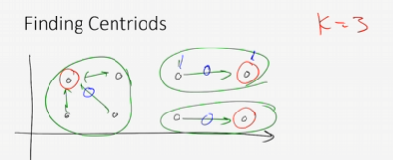
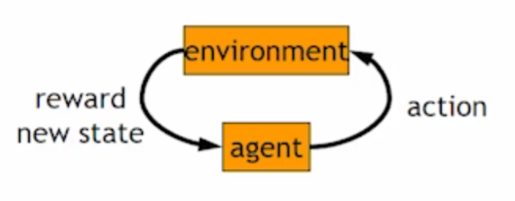
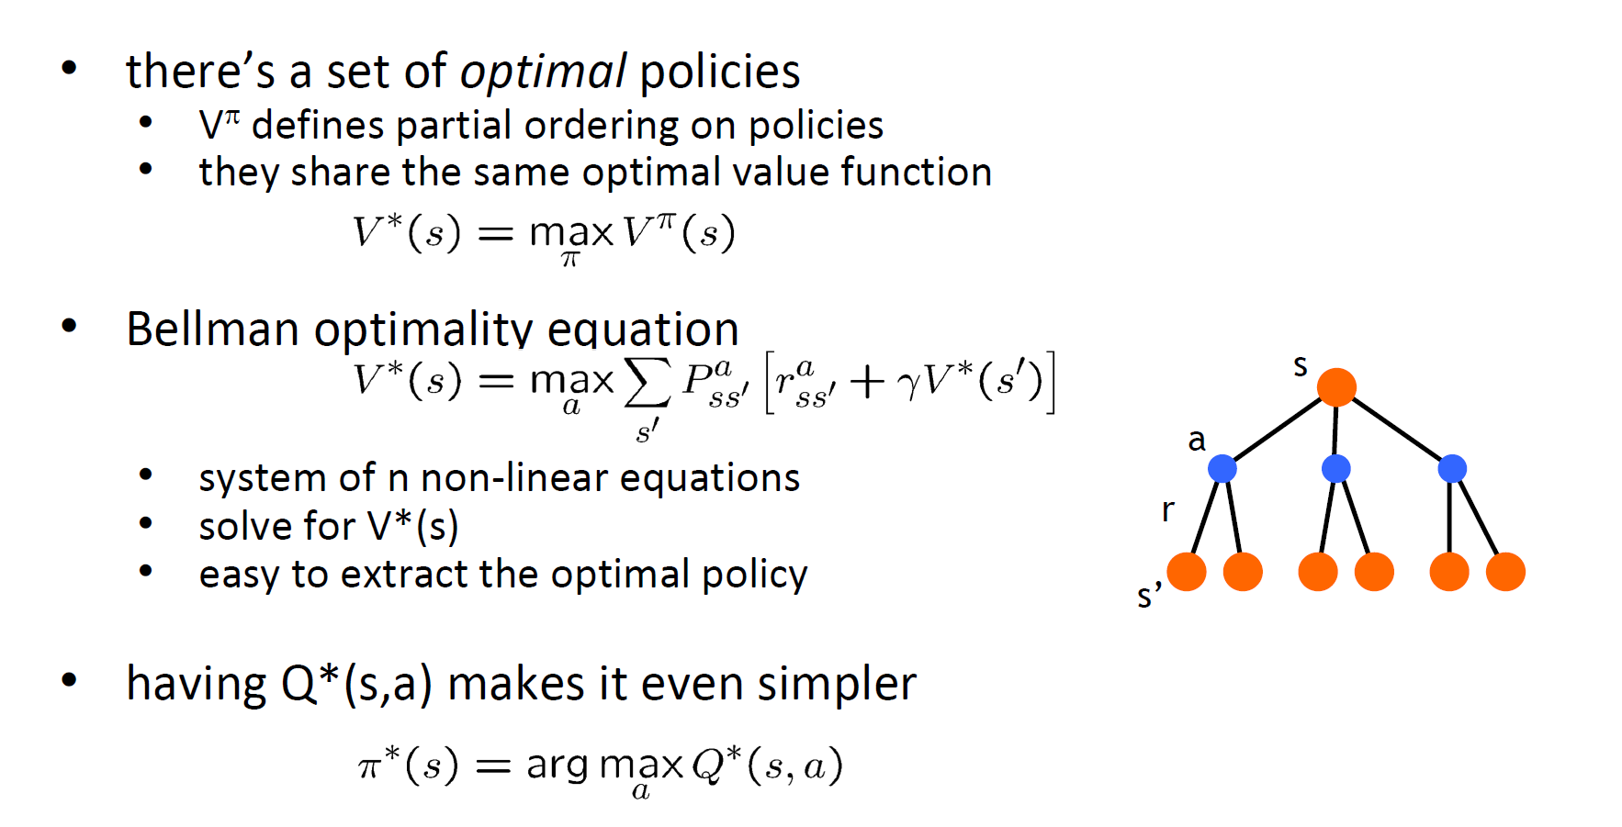
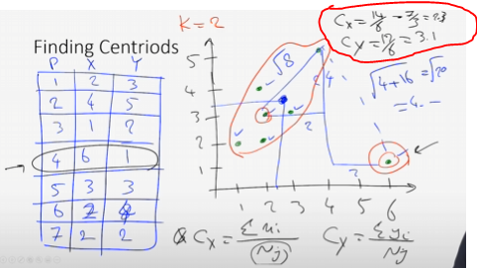
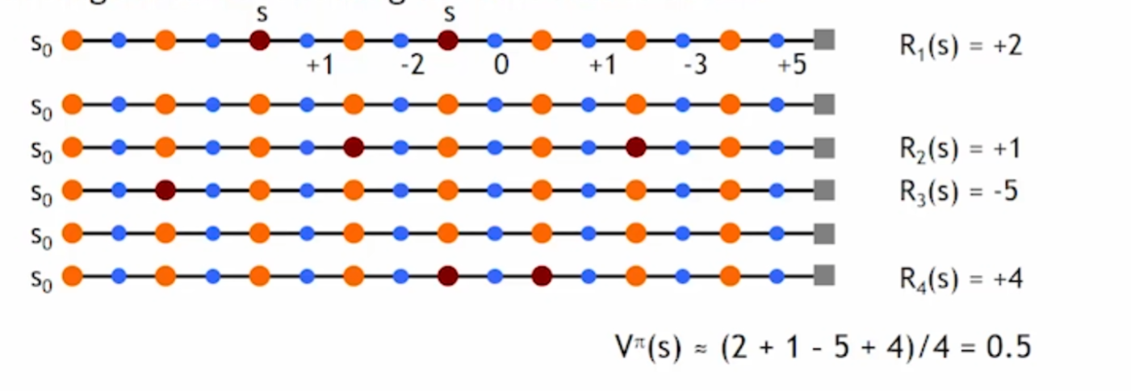
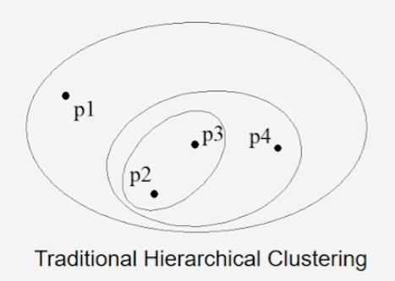
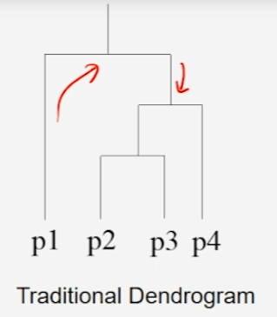
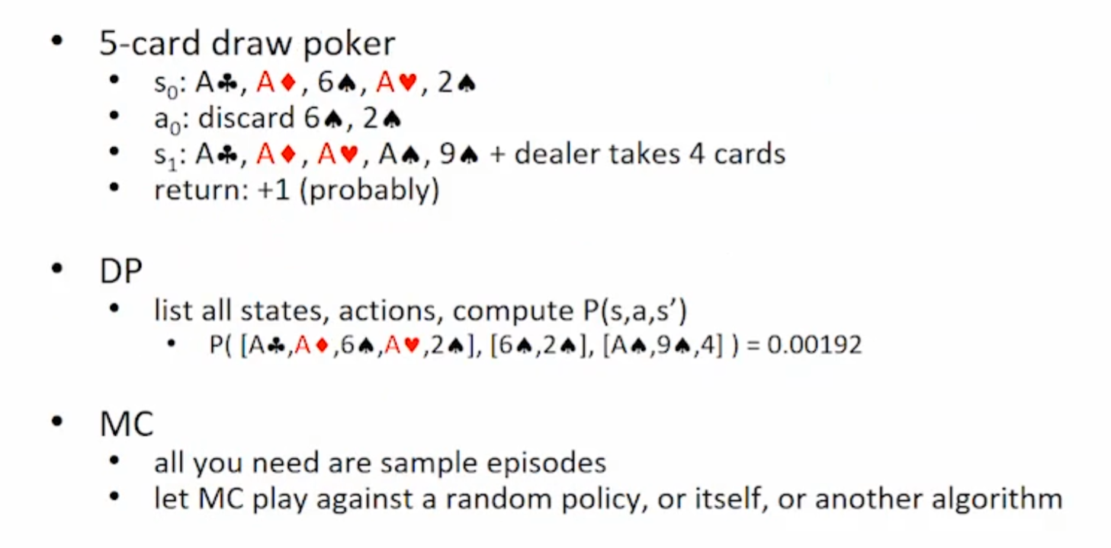
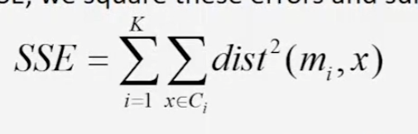
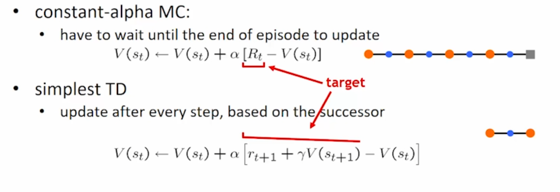
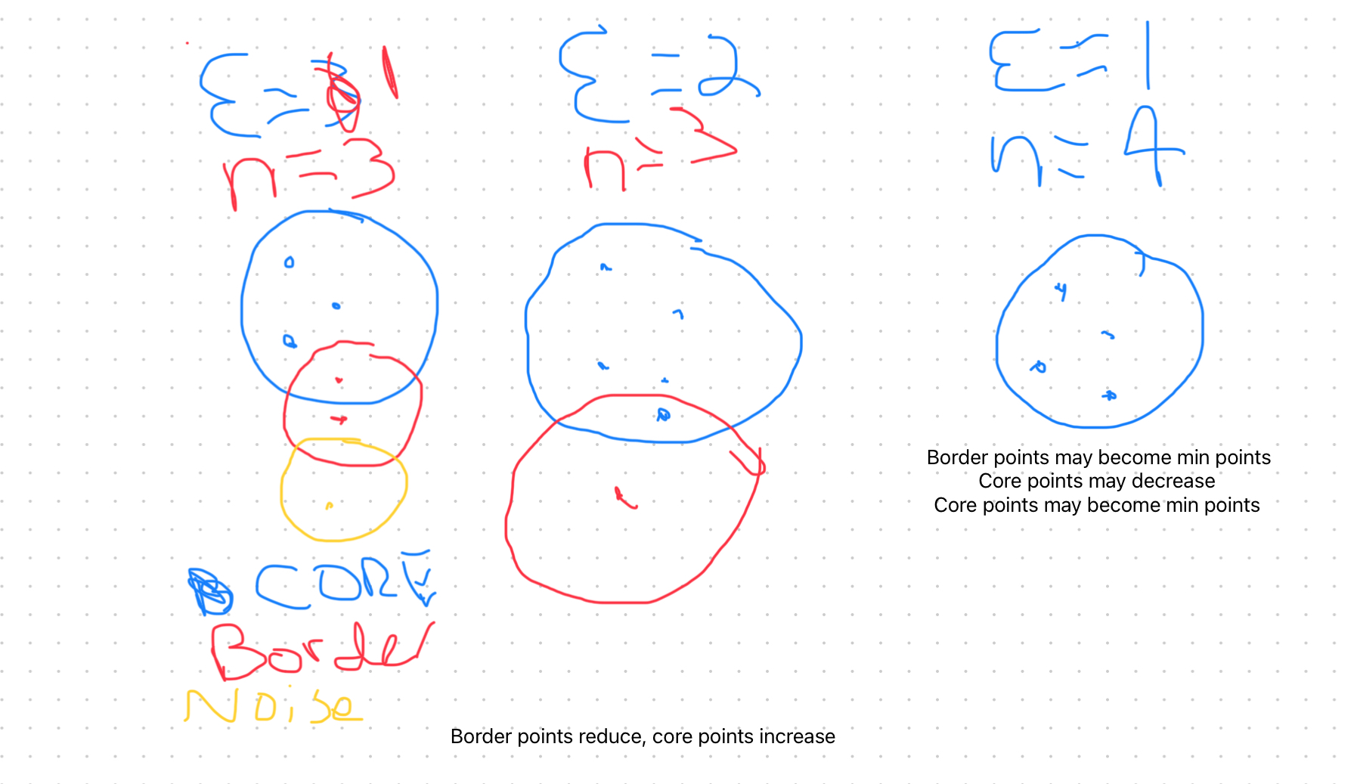
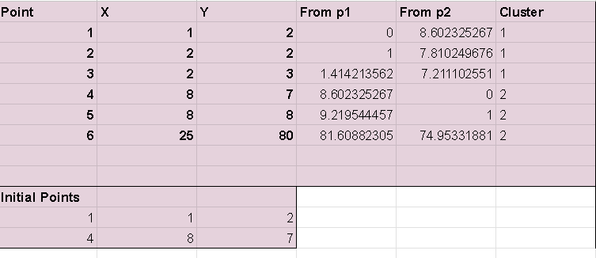
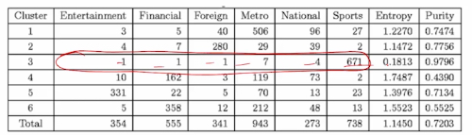

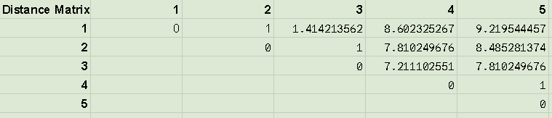
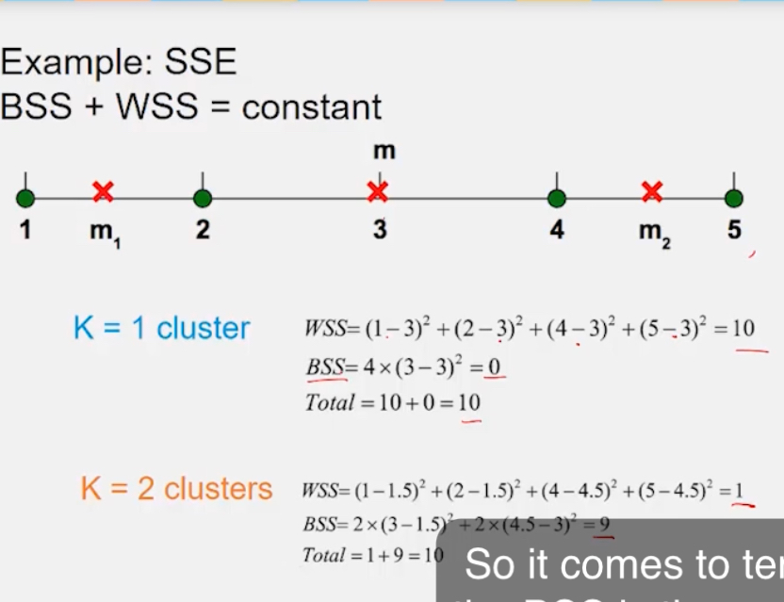
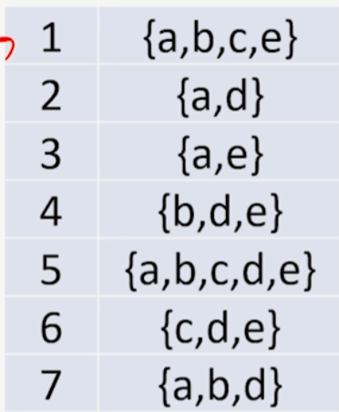
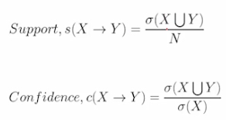
K-Means
Finding Centroids:K=2 1 & 4 initial
:
Reinforcement Learning
Module 3
For Complete-Linkage
Select Min
When comparing select complete linkage form
When selecting combination always select min
Bellman Equations
Monte Carlo Policy Eval
Hierarchical Clustering
:
Monte Carlo Policy Control
Sum of Squared Errors
Temporal Difference Learning
Dbscan
Supervised Cluster Validity: Want low entropy (well sep.) High purity
High purity means well-sep and clusters are consistent
Clustering: Distance
Distance = (Sqrt(x1-x2)^2 + (y1-y2)^2)
P1: (Sqrt(1-1)^2 + (2-2)^2) =0
P2: (Sqrt(1-8)^2 + (2-7)^2) =8.6
Cluster 1: Choose lowest distance
Centroid
C1: (1+2+2)/3, (2+2+3)/3 = 1.667, 2.33
C2: (5 + 3.5)/2, (7+5)/2 = 4.25,6
SSE
C1
P1 = (1.667-1)^2 + (2.333-2)^2 = .555
P2 = (1.667-2)^2 + (2.333-2)^2 = .222
P3 = (1.667-2)^2 + (2.333-3)^2 = .555
C2
P4 = (1.667-1)^2 + (2.333-2)^2 = 1.563
P5 = (1.667-1)^2 + (2.333-2)^2 = 1.563
Total SSE = .555+.222+.555+1.563+1.563 = 4.458
Distance Matrix
P1
Intra: Average(1, 1.414) = 1.21
Nearest: Average(8.6, 9.219) = 8.9
Coefficient: (8.9-1.21)/Max(1.21,8.9) = .86
P2
Intra Average(1, 9) = 1
Nearest Average(7.81, 8.49) = 8.14
Coefficient (8.14-1)/Max(8.14, 1) = .877
P3
Intra Average(1, 1.414) = 1.21
Nearest Average(7.21, 7.81) = 7.51
Coefficient (7.5-1.21)/Max(1.21, 7.5) = .84
P4
Intra Average(1) = 1
Nearest Average(8.6, 7.81, 7.21) = 7.87
Coefficient (7.87-1)/Max(1, 7.87) = .87
P5
Intra Average(1) = 1
Neareast Average(9.22, 8.48, 7.81) = 8.51
Coefficient (8.51-1)/Max(1,8.51) = .88
Average Coefficient: Average (.86, .877, .84, .87, .88)= .867
Sum Coefficient: .86+.877+.84+.87+.88 = 4.33
Unsupervised Cluster Validity WSS (Within) BSS (Between)
Rule Mining: {a} -> {b}
S = 3 (combos)/7(total) =~.4
40% included both a & b
C = 3(combos)/5(total a) =.6
Out of transactions of a, b was included as well
higher is better
Ignore things that don't meet minsup
Apriori Principle
100 items, 2^100 total combinations
Confidence Principle
X = {a,b} Y = {a,b,d,e}
{a,b,} -> {a,b,d,e} - {a,b} = {d,e}
Final: {a,b} -> {d,e} if this not confident any subset not confident i.e {a} -> {b,d,e}

